Slide 1
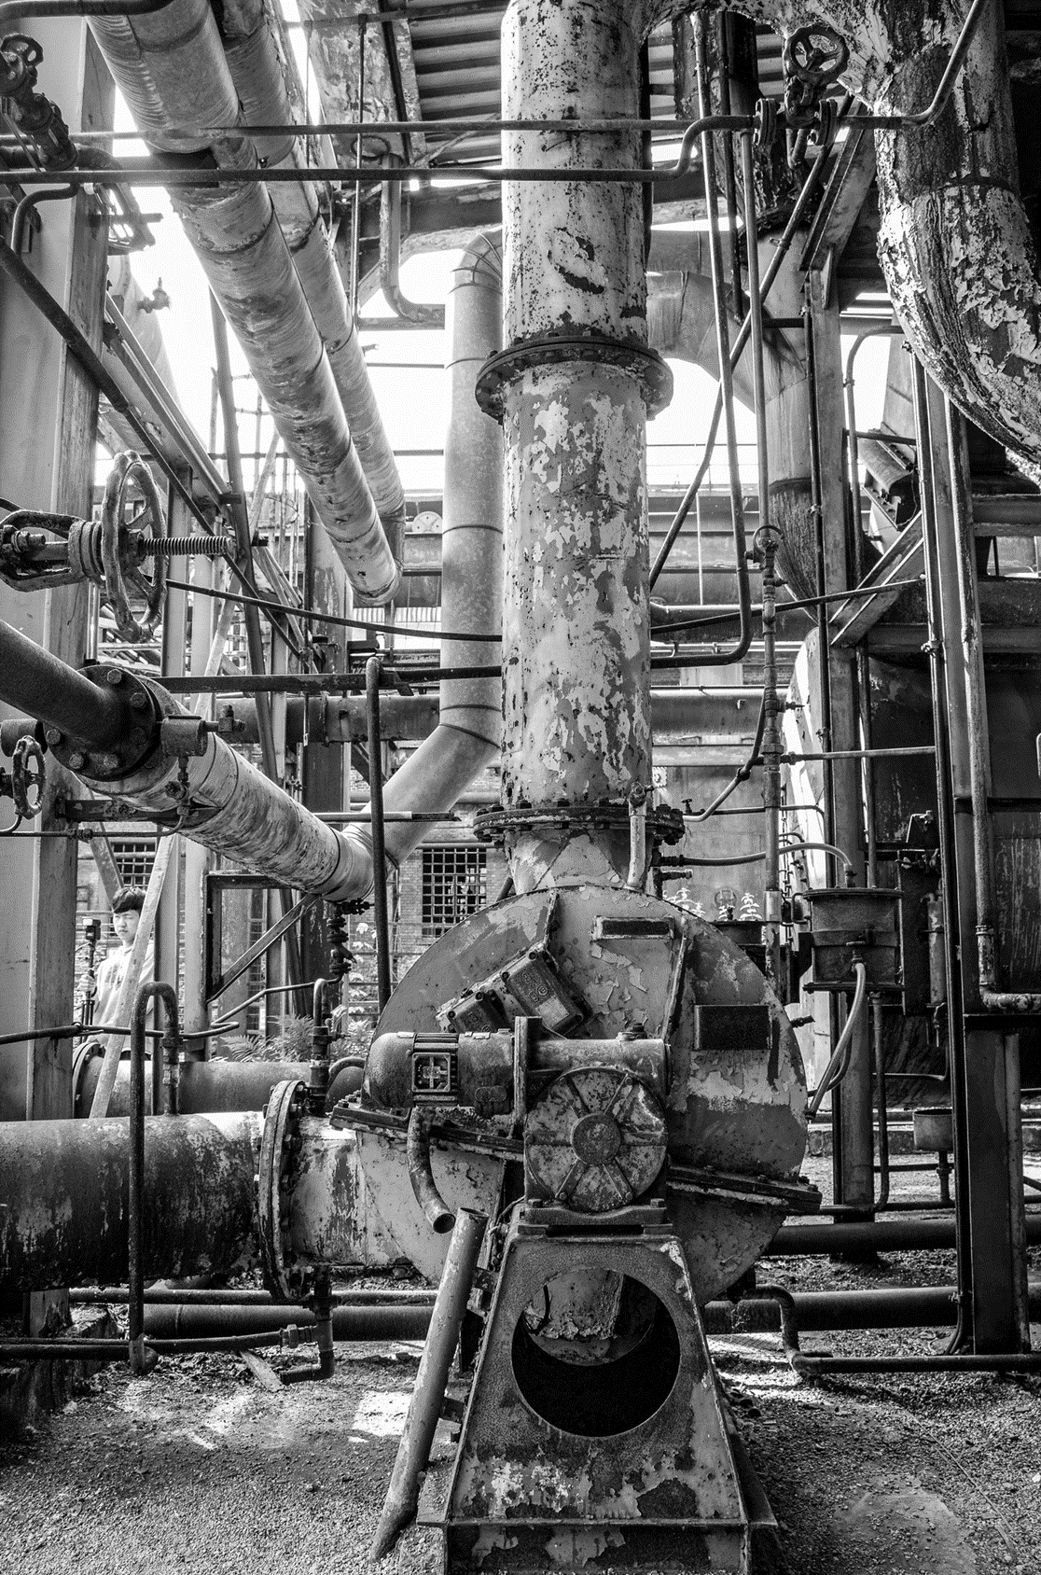


MWN CONSULTANCY
TANZANIA WATER WELLS CLASSIFICATION
WWW.MWN.COM

Slide 2
MWN CONSULTANCY
TABLE OF CONTENTS
01
OVERVIEW
03
METHODOLOGY & RESULTS
02
OBJECTIVES
04
EVALUATION

Slide 3
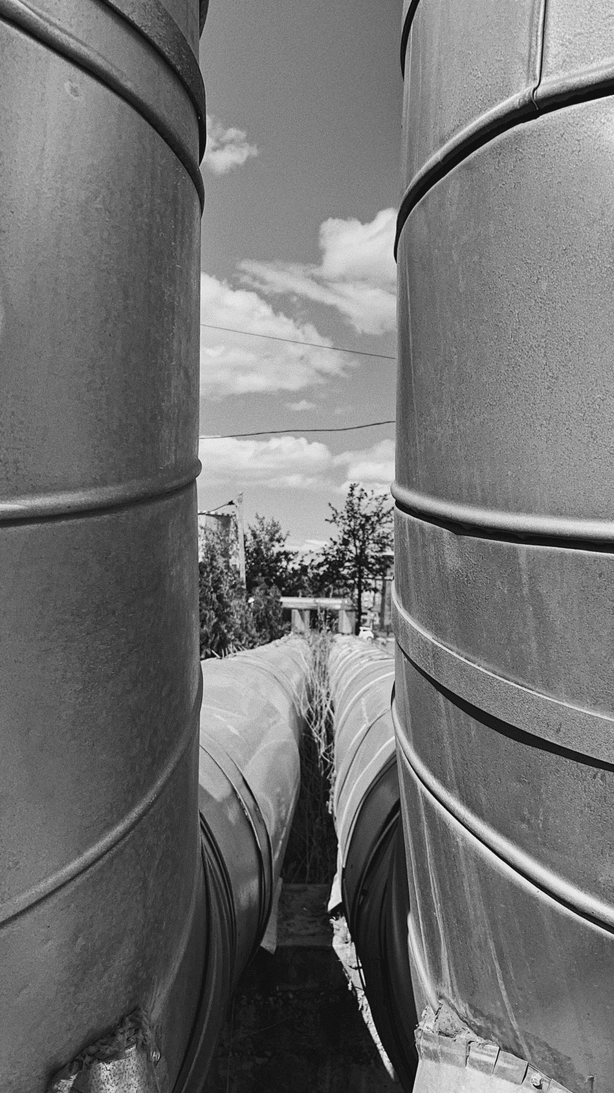
MWN CONSULTANCY
01
OVERVIEW
Water is a basic need for humans for health and sanitation. In remote areas, water wells become the source of this requirement. For a population of over 65 million people in Tanzania, being able to service and maintain this wells becomes paramount and therefore fulfils the sustainable development goal number 6: Clean Water and Sanitation
MWN Consultancy has been tasked to predict the condition of a well through the data provided. Through modeling, we should come up with the best model that classifies pumps into 3 categories; functional, non-functional, requires repair.
This model should be able to categorise the current installed base but also declare combined characteristics and features of attributes that are precursors to the conditions of the wells

Slide 4
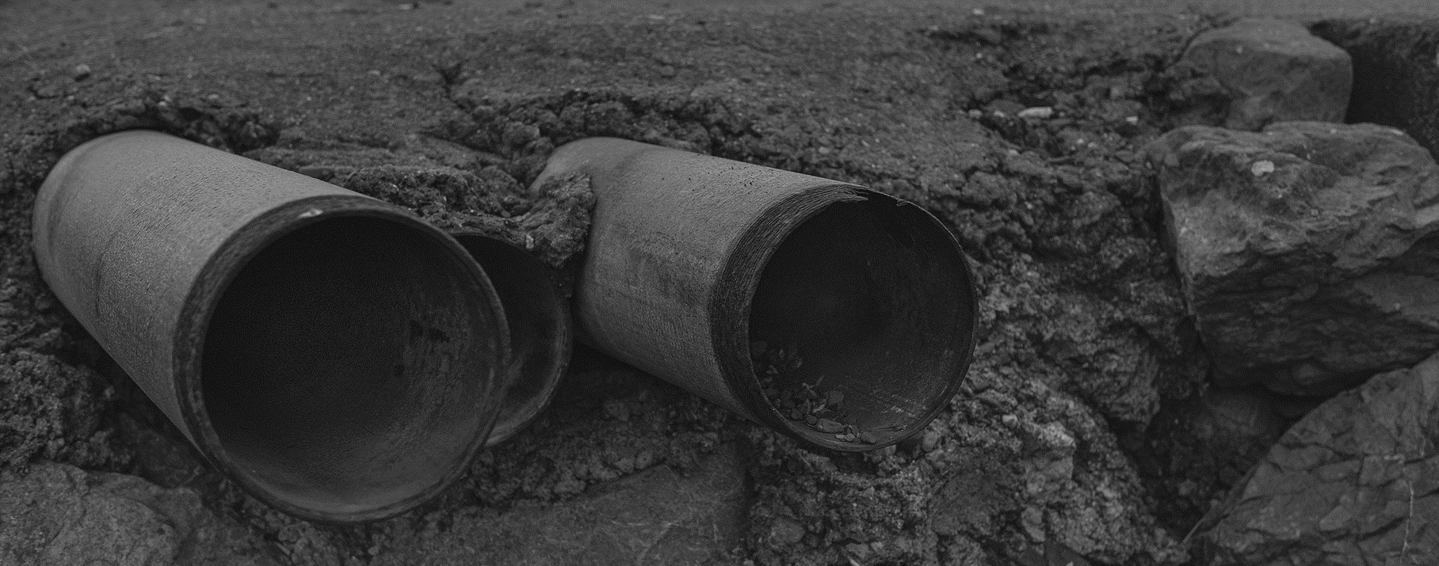
MWN CONSULTANCY
WELCOME TO PRESENTATION
I’m Maureen, and I'll be sharing with you the outcome of the process and outcome of the classification.

Slide 5
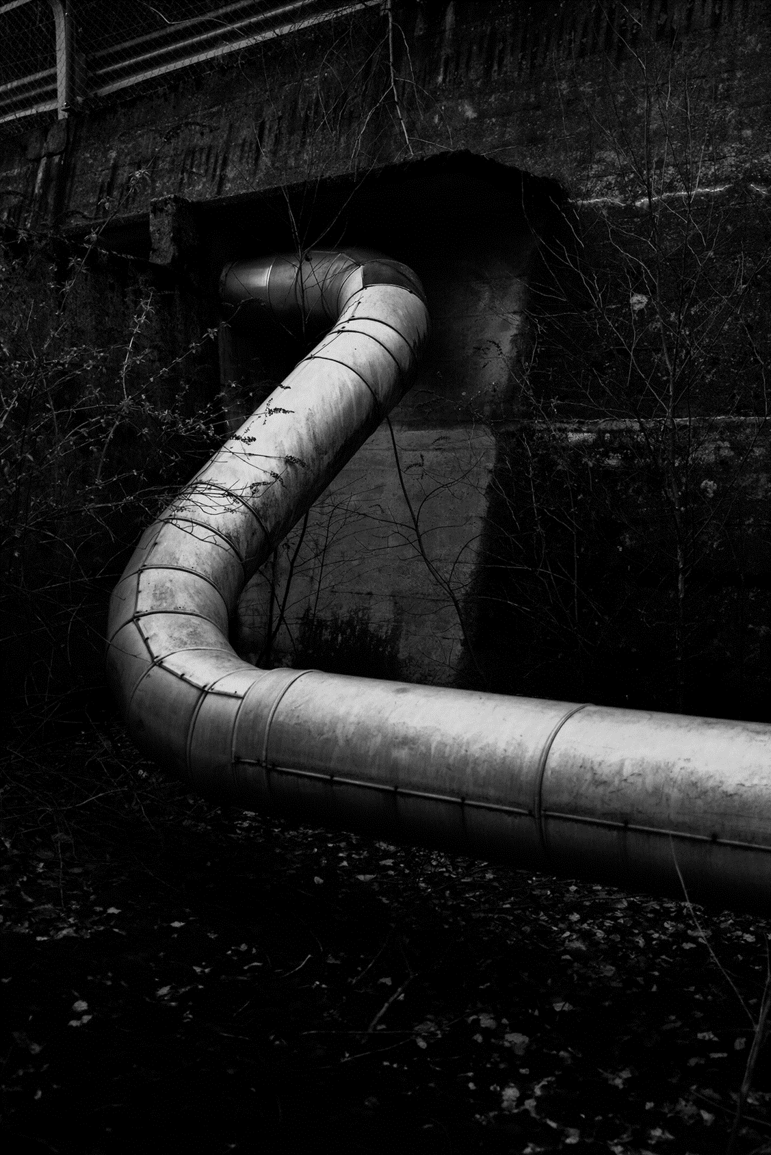
MWN CONSULTANCY
02
OBJECTIVES
Identify and present the best model that classifies the state of the well with highest accuracy
-This will be the model used to identify the status of the well to aid in maintenance, repair and status update
2. Identify which variables affect the state of the well
- This will be the common features that will determine the status of the well and would be closely monitored or noted.

Slide 6
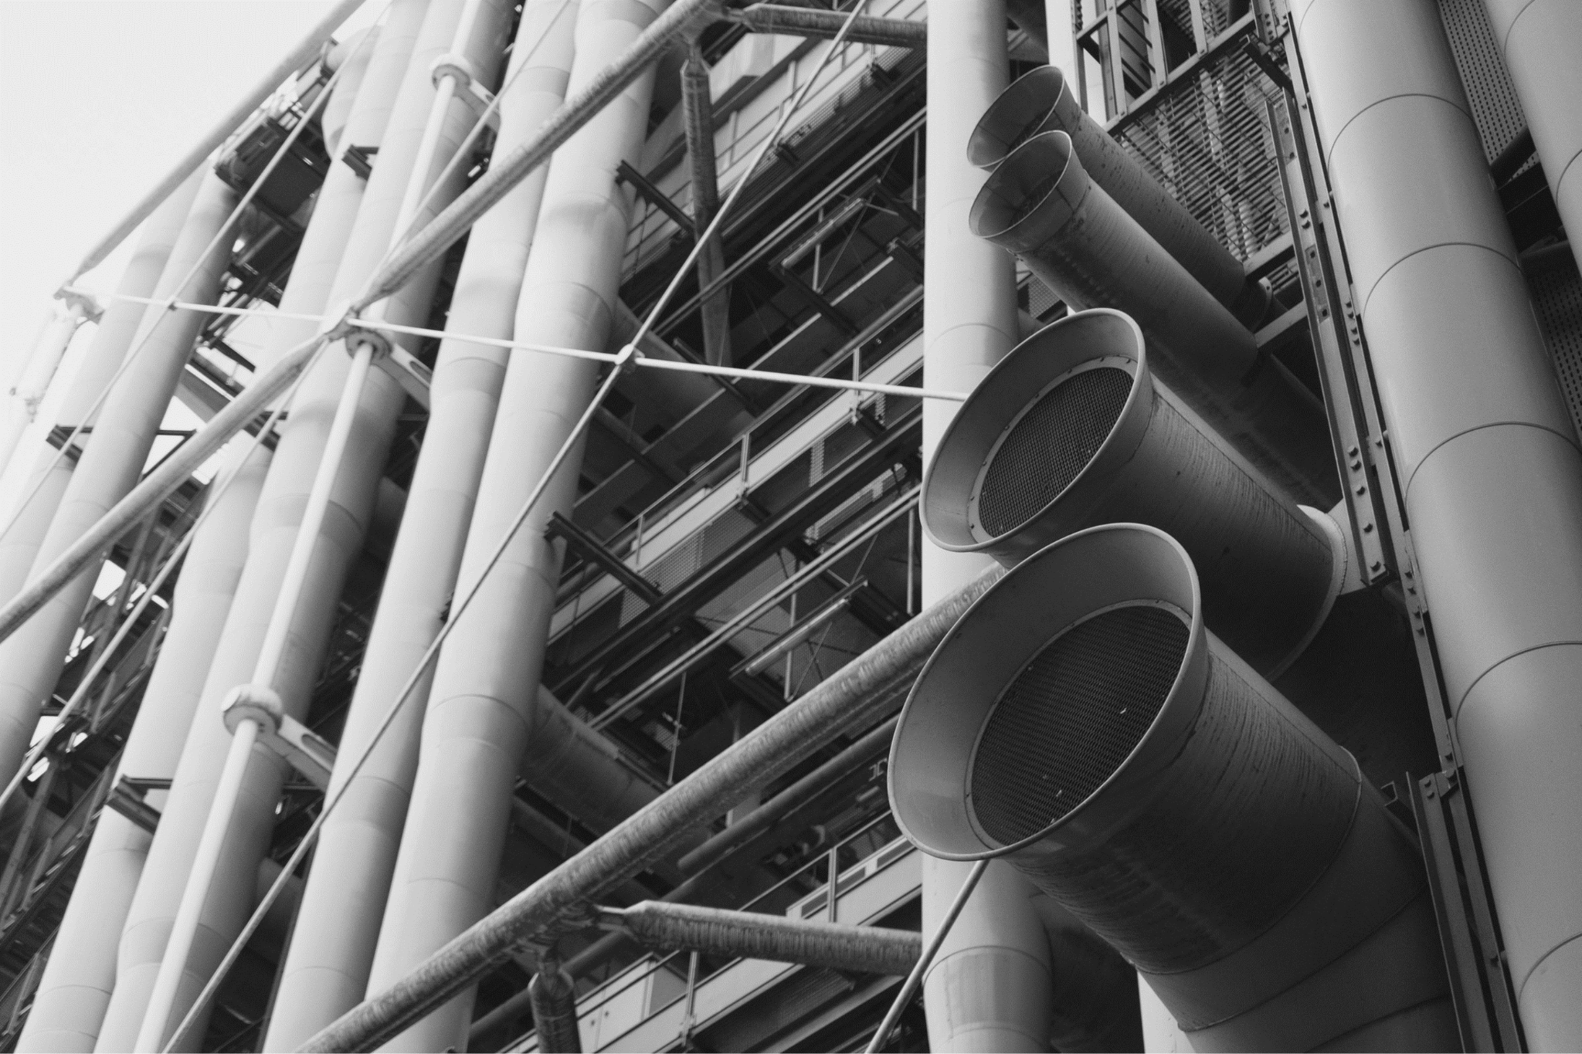
MWN CONSULTANCY
METHODOLOGY AND RESULTS
03
The dataset was imported and cleaned through removing null values and eliminating duplicates in columns as well as unnecessary data
Encoding was done to enable classification of the variables which would help in data processing of sensitive models such as Logistic regression, K Nearest neighbor and Support Vector Machine.
Scaling was also done to support the above models i.e. after identifying the skewness and percentage of outliers
The data was then passed through 6 models being ;
Logistic regression
K Nearest neighbor
Support Vector Machine.
Random Forest
Decision Trees
Gradient Boost

Slide 7
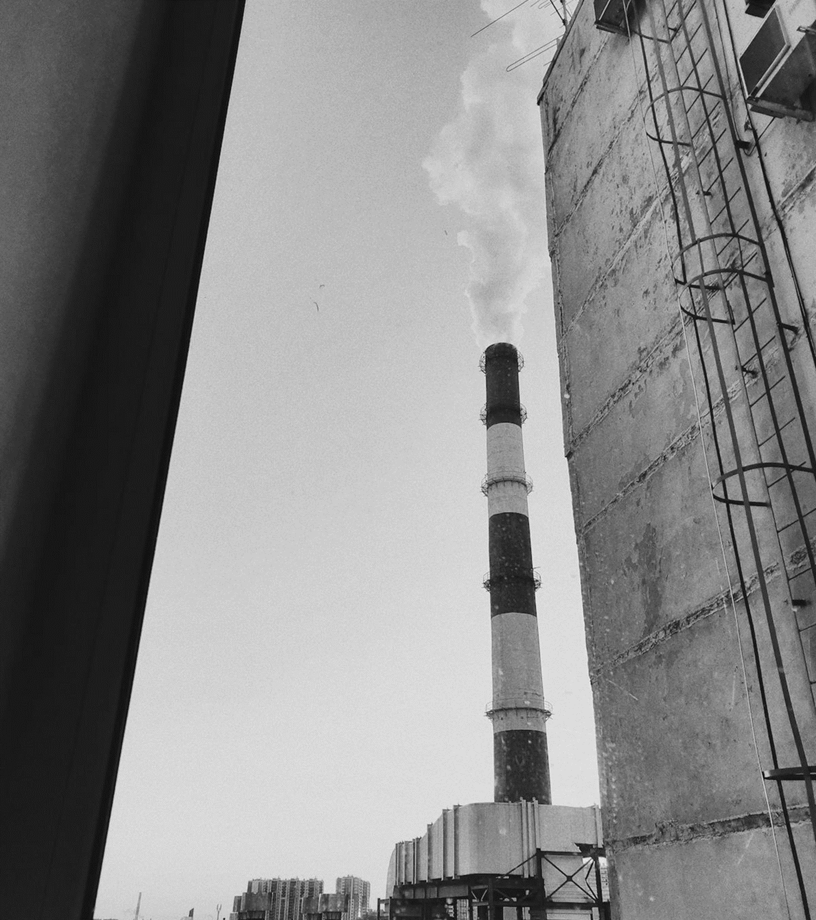
MWN CONSULTANCY
RESULTS
The models Logistic Regression, KNN, Support Vector Machine, had the least performance with below 50% levels on precision, recall and f1-score but with improved accuracy respectively.
Accuracy however is not a very reliable measure. The models performed poorly even after tuning because they are best suited for simpler and smaller datasets

Slide 8
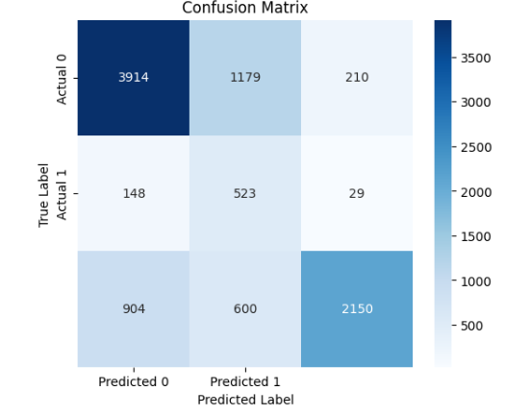
MWN CONSULTANCY
RESULTS
The best performing model was the tuned Random forest model with 75 % recall on class 1 which is the functonal needs repair.Focus on this metric will help increase repairs on faulty wells by early detection.Better tuning will increase the overall performance.All other models had very low performance on accuracy and recall and will not be best suited for this dataset
See the below result for Random Forest metrics
Classification Report:
precision recall f1-score support
0 0.79 0.74 0.76 5303
1 0.23 0.75 0.35 700
2 0.90 0.59 0.71 3654
accuracy 0.68 9657
macro avg 0.64 0.69 0.61 9657
weighted avg 0.79 0.68 0.71 9657

Slide 9
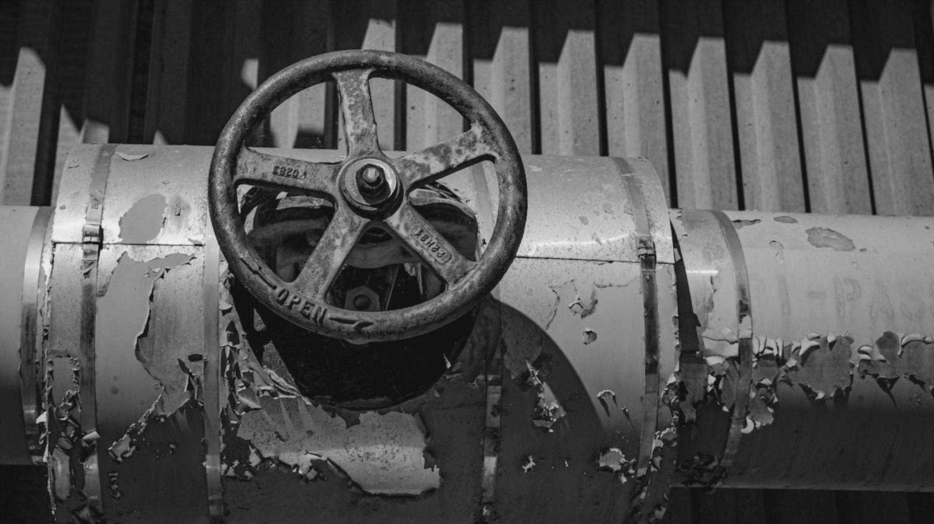
A PICTURE IS WORTH A THOUSAND WORDS

Slide 10
MWN CONSULTANCY
A BIRD IN HAND IS WORTH TWO IN THE BUSH

Slide 11

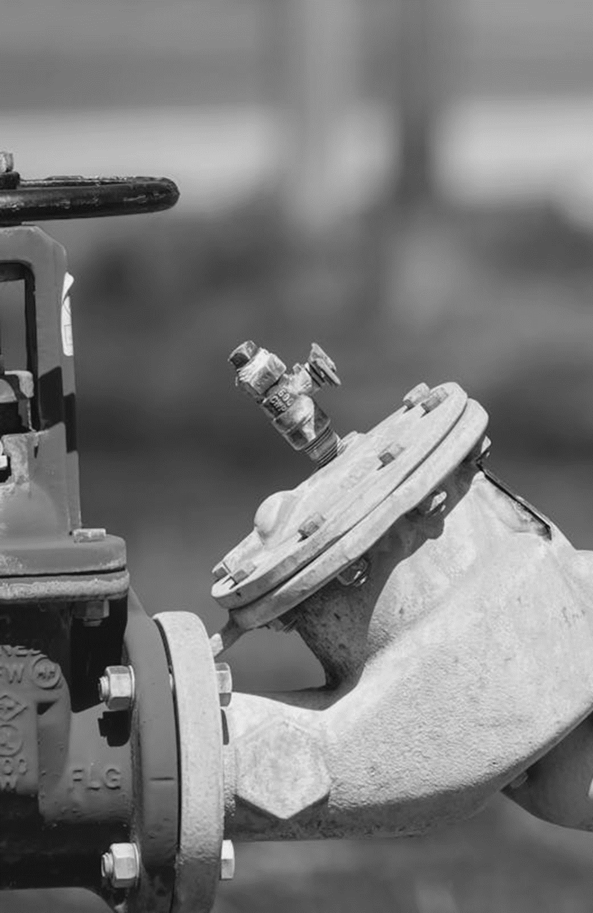
MWN CONSULTANCY
CONTACT US
Imara Daima, Itula Close
254705855005
ngahumaureen0@gmail.com

Slide 12
THANK YOU
QUESTIONS?

